Slide 1
PhonePe Transaction Geo-Visualization
Presentation Done by:
Ronald Chrishton & Kamal Basha

Slide 2
Problem Statement:
we are provided with PhonePe’s quarter wise transaction history of the past 4 years pertaining to different categories of transaction. You’re asked to develop a data frame & build a dashboard to visualize the transactions pertaining to each category in different locations.

Slide 3




TOOLS USED
Python, pandas, powerBI, MsWord, jupyter, colab

Slide 4
Approach
Data frame construction from the provided quarterly transactional data of past 4 years.
Classical machine learning tasks like Data Exploration, Data Cleaning, Feature Engineering &Data Visualization.

Slide 5
EDA Insights
Converted Json file to csv files using python.
Formed a csv by appending all individual files (state wise and quarterly transactional data of past 4 years).
EDA part done by checking its null value and removed columns which will not helpful for analysis.
Visualization done with PowerBI.

Slide 6
EDA Insights
In 2018 first,second,third quarter we found huge progress but in fourth quarter transaction became less.
In 2018 Maharashtra was high in transaction as well as in amount.
In 2019 Karnataka was top among all states in amount and transaction
In 2020 Telangana was first in Amount wise but transaction wise its in third place.
In 2021 Telangana first in amount wise and Maharashtra first in count wise.
In 2022 , we found growth compare to previous years in transaction.

Slide 7
EDA Insights
Before covid -19 Telangana had low transaction and amount , after covid Telangana region progress in good compared to 2018.
Least states of transaction and amount from our data is Ladakh, Andaman and Nicobar Island, Nagaland .

Slide 8
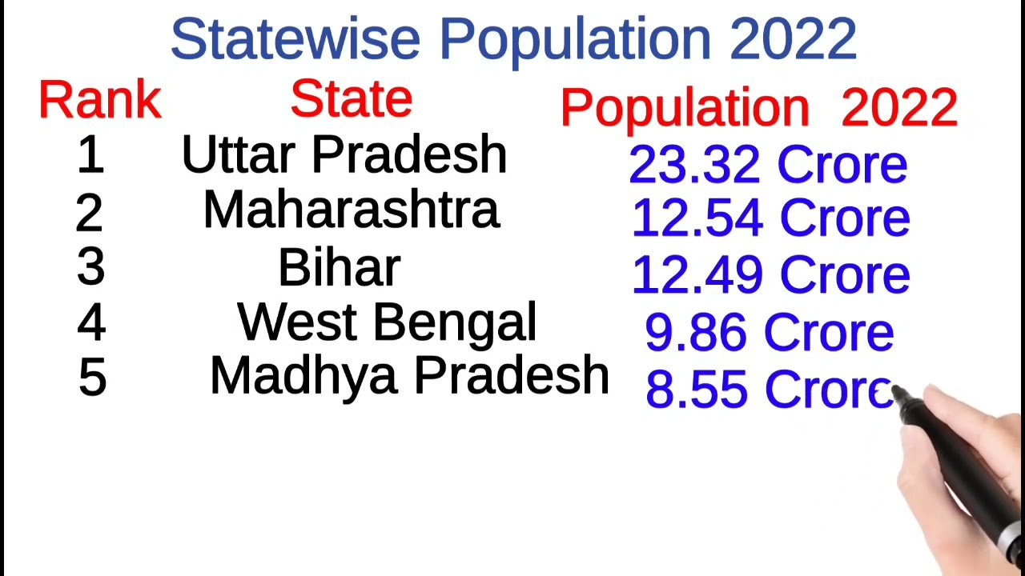
Future
In Uttar Pradesh compare to 2018 , every year we found transaction and amount getting less. As UP is most populated state should concentrate on UP for better outcome.

Slide 9
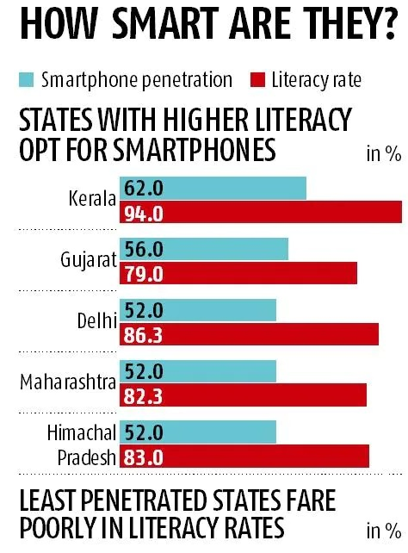
Future Development
State which are highest in smart phone usage.
According to data Kerala 2018 , transaction wise 18th and amount wise 21st. 2021, transaction wise 16th and amount wise 17^{st.}
As literacy rate and smart phone users are high in Kerala , suggested more advertisement and digital marketing for better business.

Slide 10
Future Development
The union territory of Chandigarh had the highest number of per capita digital payment transactions of all Indian states and territories at over 38 .
From our data Chandigarh is in 13th place in transaction and amount , as its highly consumption of digital transaction , its best place to improve the business.

Slide 11
Future Development
Odisha has 6,099 villages, highest in the country, without mobile connectivity. Arunachal Pradesh has 2,223 villages, Madhya Pradesh has 2,612, and Maharashtra has 2,328. Andhra Pradesh has 1,787 villages without Internet and Jharkhand has 1,144 such villages.
Better to reduce the investment for marketing at these regions .
Kerala, Punjab, Tamil Nadu, and Haryana are some of the few states which have achieved the highest penetration of mobile services in their villages.

Slide 12
Future Development
Which state has highest number of ATM in India 2021? TAMIL Nadu .
TAMIL Nadu is the state with the most ATMs in India, numbering 28,540, Malaysia Nanban reported. This is based on latest statistics issued by the Reserve Bank of India.
Marketing strategy have to be different and continuous for better business. AT PRSESENT PROGRESS OF TAMILNADU PROGRESS IS NEGATIVE AS COMPARE TO 2018 .

Slide 14

THANK YOU FOR GIVING US WONDERFUL OPPERTUNITY

